Slide 1
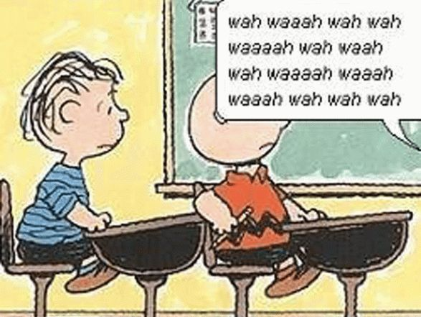
Why Won’t They Listen to Me!?
Jamie VanderLinden, LCSW, LAC

Slide 2
Road Map
Introduce Motivational Interviewing and the Spirit of MI
MI Vocabulary Words
4 Tasks of MI
With Skills You Can Use Today!

Slide 3
What is Motivational Interviewing?
A particular way of talking with people about change and growth to strengthen their own motivation and commitment.
MI flows like a normal conversation – It's not something being done to a patient.
Directional and Purposeful
Compassionate attention to the person while watching/listening for change and growth
MI is a way of doing what you already do.
It is person-centered.
It is not primarily seeing deficits, diagnoses or problems to be solved.
It sees a person with strengths, hopes, and relationships who wants to be heard, valued, and viewed as competent.

Slide 5
Spirit of Motivational Interviewing
Partnership
People are experts on themselves, and if they are the ones wanting to change, you need THEIR expertise!
Acceptance
Belief that people have inherent worth and do not need to earn or prove that they deserve respect.
Compassion
A commitment to support positive growth that is in the best interest of your patient.
Empowerment
Helping people realize and use their own strengths and abilities.
Adjusted in the 4th Edition to emphasize the importance of people’s own strengths, motivations, resourcefulness, and autonomy.

Slide 6
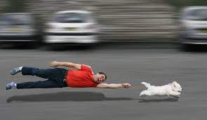
Our Role:
We are not responsible for the individual’s decision to change or not.
We are like a tour guide…
Listen well to where they want to go
Don’t just follow them around.
Don’t pull them where we want them
Share our knowledge.
Combine expertise with what they care about and want.

Slide 7
MI Vocabulary:
Sustain talk: Arguing against change – normal ambivalence
Discord: Reflecting discomfort with the relationship
May be increased or decreased by the interviewers' behaviors.
Poor outcomes when not addressed.
Change Talk
Anything a person says that moves them towards or away from taking a particular action.
Shows their motivation and intention.

Slide 8
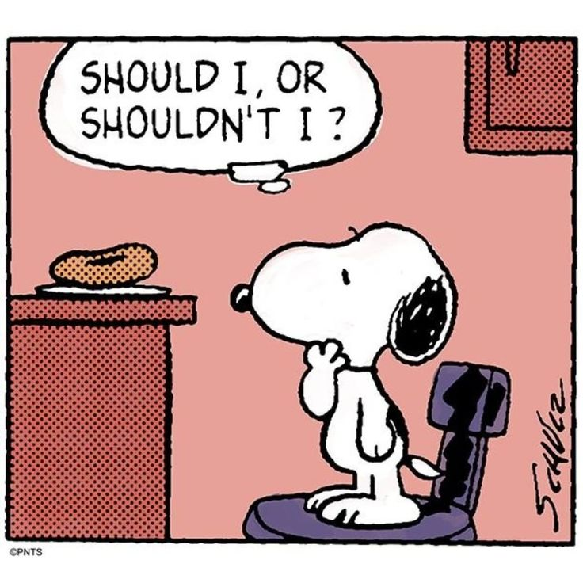
Ambivalence
Ambivalence – simultaneously wanting and not wanting something
This is a normal part of the change process.
Not resistance
No one is unmotivated.
We are not creating motivation but evoking it.

Slide 9
The Fixing Reflex
We have a natural desire to want to “fix” what we believe is the problem…
We tell them what WE think they should do…
Which puts the other person on the defense and arguing the other point of view.
Example:
How might we respond to this individual?

Slide 10
Resistance:
Arguing or not “complying” with treatment.
When you agree with the professional – you have insight.
Invites discord – I'm trying to help – THEY are resistant.
Challenge – avoid using the word "Resistance"

Slide 11
Four Tasks of MI:
Engaging
Can we walk together?
Focusing
Where are we going? What shall we talk about?
Evoking
Why would you go there?
Planning
How will you get there?

Slide 12
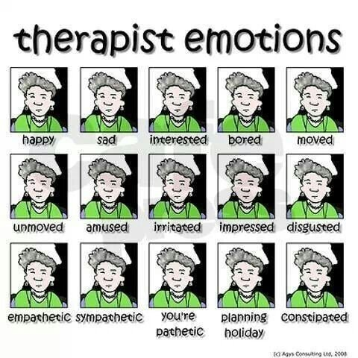
Engaging – Can we walk together?
Taking an active interest in understanding this person's experience from their point of view
With an attitude of curiosity and appreciation for their capabilities
Use accurate empathy to voice and test for understanding
Be Genuine!

Slide 13
Open Ended Questions
Invites people to talk
What's on your mind?
How are you hoping I can help?
How would you like things to be different?
Creates forward momentum in the conversation as you are learning about the person

Slide 14
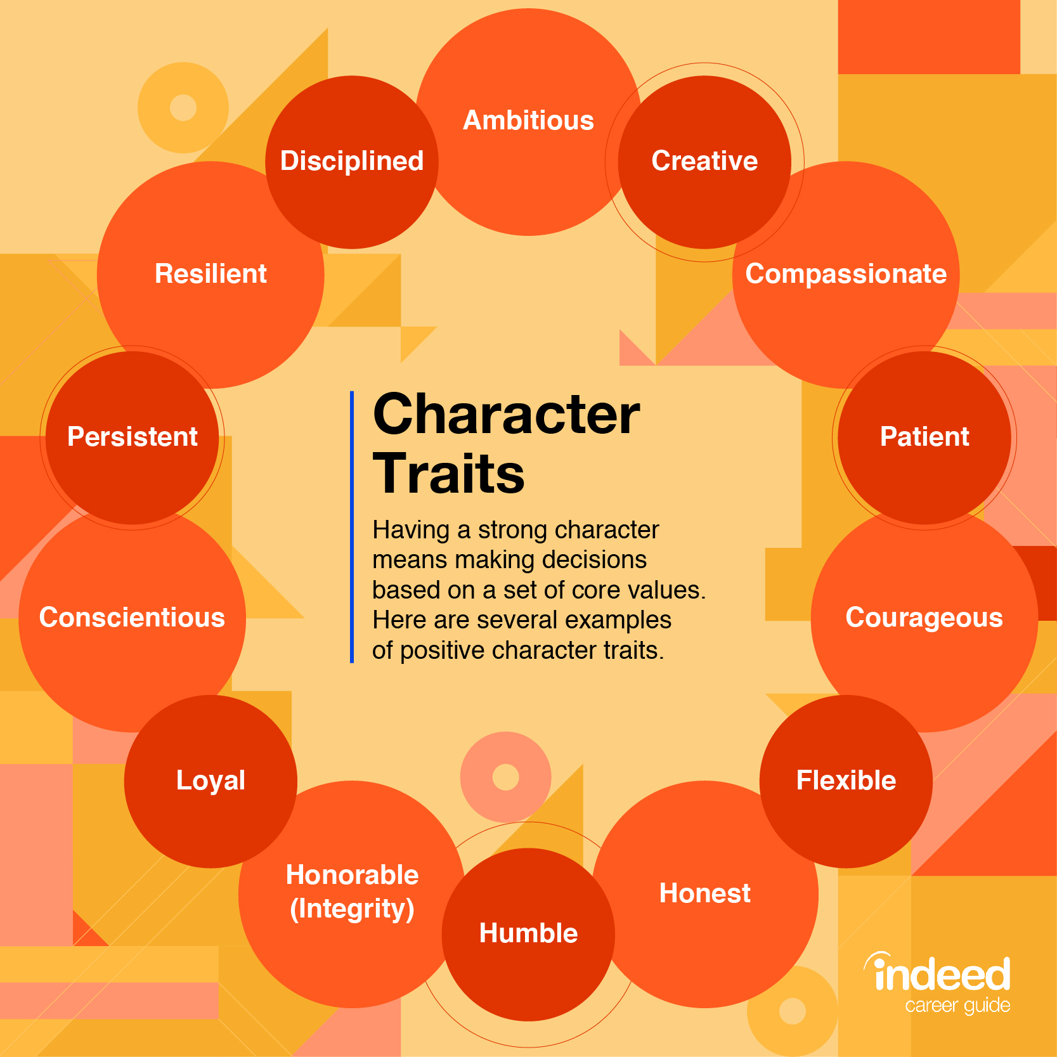
Affirmations:
Elicits change talk and confidence.
Affirm character traits, not just behaviors.
Use the word “you” instead of “I.”
Using “I” takes focus off the person and can suggest that when they do what we want, they are “good.”

Slide 15
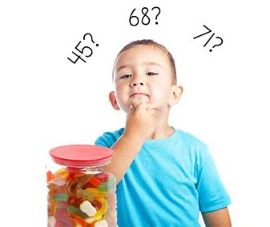
Reflections
Interpreting what you believe the person is saying
Get your understanding as close as you can to their meaning
You make your guess and get immediate feedback - "Yes, and..." Or "No, not that. It's..."
Encourages the person to pause and hear what they just said.
Downward tone of voice – not a question

Slide 16
Reflections: Tone of Voice
Test:
You're angry with your mother?
You're angry with your mother.
How does this feel different? How might responses differ?
Test:
You don't see anything wrong with what you did?
You don't see anything wrong with what you did.

Slide 17
Summaries
Collected reflections of several things you heard.
Individual hears themselves mirrored
You can offer "mini-summaries" along the way.
"Here's what I've heard so far. Let me know if I've missed something."
Be intentional about what you pull into your summary…

Slide 18
Preparatory Change Talk:
Desire – “I want…”
Want, wish, like, and love
Ability – How confident they are that they could make the change
Can, could, able, and possible
Reasons – “if, then…” Advantages and disadvantages
Changing my diet would help me manage my diabetes.
Need – Emphasizes urgency to change; it is important, but doesn’t specify why it is
“Have to, need to, must, etc.”

Slide 19
Summaries…
Like a bouquet of flowers
As you hear 2-3 change statements, you gather them (in your mind) then put them together in a summary
You’re not gathering evidence to use against a person
Have a mind of curiosity and acceptance
Be an honest mirror of what you’ve heard and allow the person to make their own conclusion

Slide 20
OAR-ing Tips:
Ask an open-ended question
Person hears themself answer
Aim for 1 open-ended question followed by at least 2 reflections
Listening for affirmations
You reflect – they hear again – may clarify, gain understanding or hear in a new light
When you reflect – focus attention on an aspect you hope to hear more about
When you affirm – choose an action or attribute you hope to hear more about

Slide 21
Focusing-Where are we going?
This is often the first thing we do
What brought you in today?
How can I help you today?
Articulating a clear goal is fundamental to motivation
Need a clear goal and plan for how to achieve them – predicts therapeutic outcomes

Slide 22
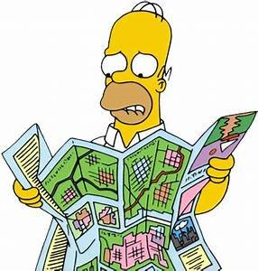
Focusing Skills:
With a vague goal:
Clarify: What changes do they want to make?
With a clearly articulated goal:
Clarify: Reasonable action steps
Ask - elicit what they already know. what concerns do you have?
Offer - ask permission - then share advice or feedback - get consent then offer
Ask - what do you think? what would you want to do with that? etc

Slide 23
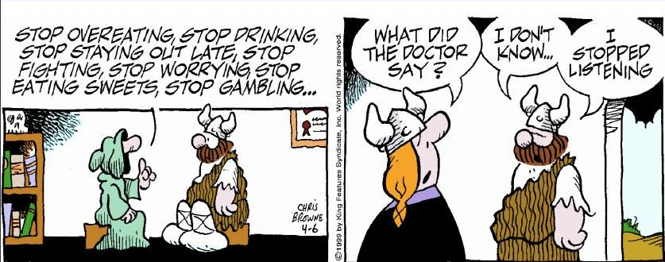
Evoking – Why would you…
“Calling forth what is already present”
We are not installing motivation; we are inviting people to give their own reasons and resources a voice.
EMPOWERMENT
Why and How will we get there…

Slide 24
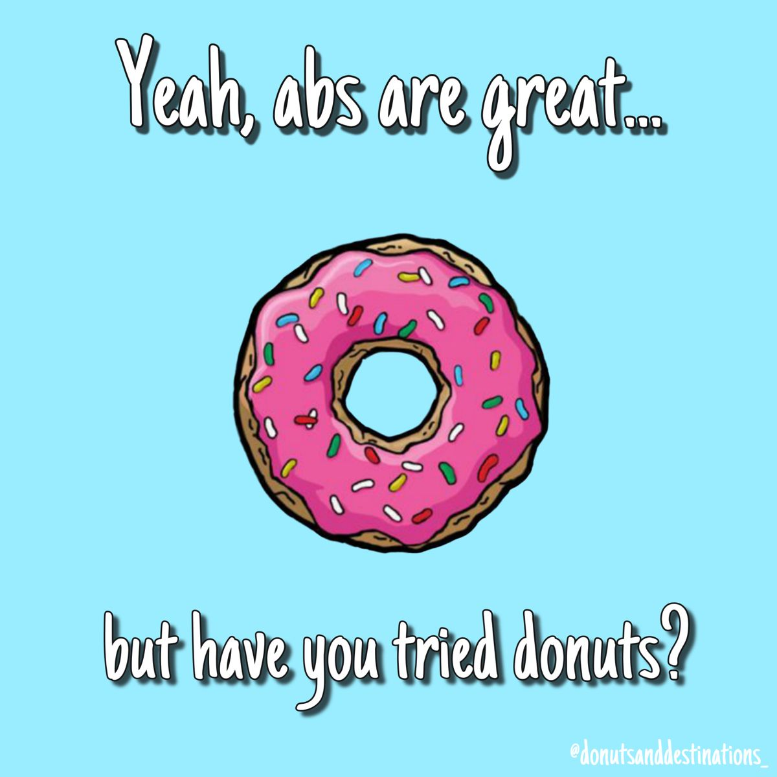
Evoking Skills:
Why do you want to do this?
How much does it matter to you?
What reasons are there for you to do this?
How important is this?
The change must be important, and they must have confidence.

Slide 25
Importance and Confidence
Why a 4 and not a 1?
Notice you get change talk
Why a 4 and not a 7?
Notice you get sustain talk.
On the confidence scale, we want the patient to rate themselves 7 or higher.

Slide 26
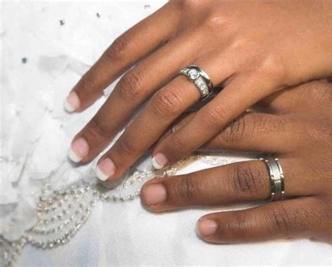
Mobilizing Change Talk:
Commitment Language
Assurance it will happen
“I will.” “I promise.” “I guarantee.”
Activation Language
Leaning towards action but haven’t quite decided
“I’m willing to.” “I’m considering it.” “I’ll think about it.”
Taking Steps Language
The person indicates they’re already taking steps.
“I filled my prescription.” “I called 3 places about possible jobs today.” etc. “I bought a ring.”

Slide 27
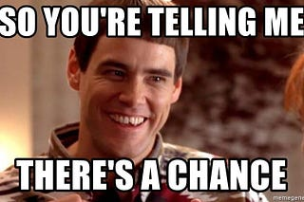
Planning - How will you get there?
Evoking the “how” of their change
Focusing on the specifics of the plan
Must fit into the person’s lifestyle – their daily patterns and routines
Where, when, and how etc.
Must be reasonable!

Slide 28
Why to How…
Summarize – Then ask…”What next?”
What are you considering?
What might you try?
How do you want to move forward?
“You know yourself best, how do you think you could move forward?”
“How important is this to you? How confident are you?”

Slide 29
Real Play
Break out rooms!
Select 1 person to be the interviewer and 1 to be the person considering a change.
Choose a real situation you feel ambivalence about:
Drinking less coffee
Exercising more
Eating healthier
Spending less time watching Netflix
Cutting your bangs…
Spend about 6-7 minutes in the interview; Give feedback.
Try to talk LESS than the person you are interviewing and using your OARS

Slide 30
Resources
Miller, W. Rollnick, S. (2023). Motivational Interviewing; Helping People Change and Grow, 4th Edition
www.motivationalinterview.net (training tapes, articles, bibliographies, training opportunities)
www.motivationalinterview.org (MI resources ATTC website)

