Slide 1
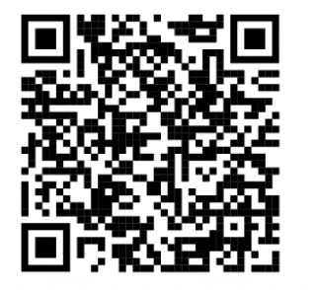
June 13th 2024
Jason Pomaski, MBA, CISSP
Virtual CISO

Slide 2
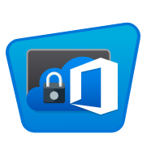
Microsoft 365 Made Simple & Secure
We Manage Complexity - You Focus on Business
Microsoft 365
Management Made Simple
Security & Compliance
Security Made Simple
Business Automation
Provisioning Made Simple
Flat Pricing
Made Simple

Slide 5
Microsoft 365 Made Simple & Secure
We Manage Complexity - You Focus on Business
The Challenge of Microsoft 365:
Complexity
Hundreds of configurable controls
Keeping pace with new features
Shared Responsibility Gaps
Consistency of enterprise permissions
Backups must be properly configured
Maintaining and securing legacy platforms including point solutions.
Data management and classification
Hybrid deployments
Security & Regulatory Compliance
Healthcare
Financial Services
Real Estate
Government
Generative AI unknowns
Productivity
Hybrid Workplace
Onboarding staff quickly
Offboarding securely
Use of BYOD
Getting the most out of Microsoft 365
Collaboration
Document / Version Control
Resource Contention
Ownership and Accountability
Resource constrained IT team
Continuous Learning Requirements
IT is not aligned to business objectives or priorities

Slide 6
Microsoft 365 Made Simple & Secure
We Manage Complexity - You Focus on Business
Why Digital Bunker 365:
Easy Onboarding with
Assessment & Remediation
Assess and report on Microsoft 365 environment
Triaged Remediation Roadmap
Project Management of Remediation Plan
Implementation of Remediation Plan
Platform Implementation
Architect Customer Environment
Onboard customer to platform
Security & Compliance
Configure and manage Entra Identity and Access Management (IAM)
Monitor security controls and events
Generate automated alerts
Continuous enforcement of over 125 controls
Alignment with organization’s Policies, Procedures, and Process.
Independent third-party oversight
Microsoft 365 Experts
Configure and manage Microsoft Exchange, SharePoint, Teams and OneDrive
Manage Files/Directories and data classification
Manage backups and data retention
Business automation - Onboarding / Offboarding of staff
Expert's Expert
Customer Engagement
Secure Customer Portal
Help Desk
Automated Change Control Request and Approval Process
Monthly reviews including security assessment reports and associated remediation.
Customer Dashboard
Custom Alerting and Monitoring

Slide 7
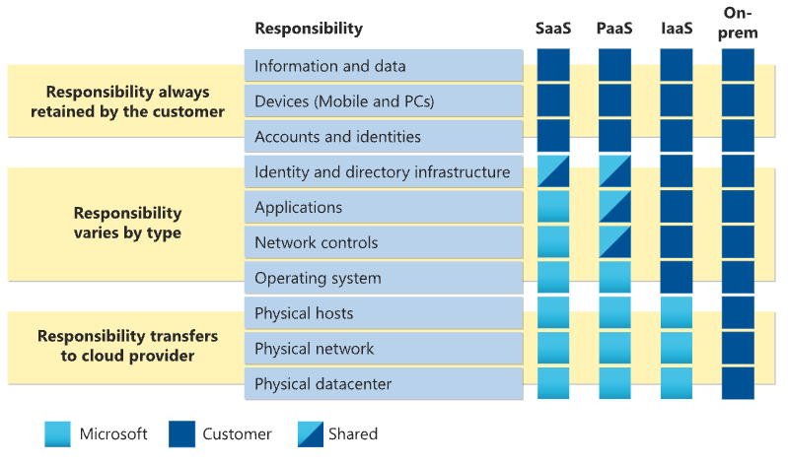
Microsoft 365 Made Simple & Secure
We Manage Complexity - You Focus on Business
Navigating Shared Responsibility:
Client Responsibility
Assess and report on Microsoft 365 environment
Triaged Remediation Roadmap
Project Management of Remediation Plan
Implementation of Remediation Plan
Digital Bunker 365 Responsibilities
Assess and report on Microsoft 365 environment
Triaged Remediation Roadmap
Project Management of Remediation Plan
Implementation of Remediation Plan

Slide 8
Managing Complexity
Assess and Remediate
Implementation
Manage Multifactor Authentication (MFA)
Establish Access Controls
Create Conditional Access Policies
Establish Compliance Protocols
Spam Filtering
Phishing Detection and Prevention
Data Loss Prevention (DLP) Policies
Email Spoofing Protection (SPF, DKIM, DMARC)
Email Content Filtering
Attachment Scanning for Malware
Block Executable File Attachments
Implement Email Archiving
Monitor and Analyze Email Logs
Secure Email Gateway
Automatic Forwarding Restrictions
Enforce Strong Password Policies
Audit Email Access and Usage
Retention Policies for Emails
Email Encryption
Access Control for Sensitive Emails
Disable Auto-Download of Email Attachments
Monitor for Unusual Email Activity
Quarantine Suspicious Emails
Whitelisting and Blacklisting of Email Addresses
Backup Solutions
Email Account Compromise Detection
Manage Email Protocols
Monitor for Outbound Data Exfiltration
Restrict External Email Access
Implement Advanced Threat Protection (ATP)
Regularly Update Email Security Policies
Protect Against Business Email Compromise (BEC)
Use Secure Links in Emails
Use Secure Links in Emails
Restrict Email Access on Mobile Devices
Secure Email Client Configurations
Monitor Email Flow for Anomalies
Manage Use of Trusted Email Domains
Limit Email Attachment Size
Implement Email Sender Verification
Restrict Administrative Access to Email Settings
Disable Email Auto-Reply to External Addresses
Enable Audit Logging for Email Admin Activities
Secure Email Distribution Lists
Configure Email Alerts for Suspicious Activities
Monitor Email Bounce-Backs
Implement Role-Based Access Control (RBAC) for Email
Protect Against Email Address Harvesting
Deploy Anti-Malware Solutions for Email
Conduct Regular Email Security Audits
Restrict Email Use for Critical Communications Only
Monitor Email Metadata for Anomalies
Implement Least Privilege for Email Access
Ensure Secure Email Deletion Practices
Regularly Test Email Security Controls
Enforce Secure Email Usage Policies
Protect Email Accounts with Conditional Access
Review and Update Email Security Configurations Periodically
Monitor and Control Third-Party Email Integrations
Implement Strong Email Authentication Methods
Enable Email Notifications for Security Events
Ensure Compliance with Email Retention Laws
Secure Shared Email Inboxes
Implement Geo-Fencing for Email Access
Enforce Use of Secure Email Clients
Regularly Review and Purge Inactive Email Accounts
Dashboards
Ticketing System

Slide 9
Value Add Specific to MTPCA Members
In-kind of up to four hours per week of Microsoft 365 consulting
Navigating Microsoft including accessing non-profit pricing and getting value from not-for-profit offerings. This includes the free $3500 of Azure credit per year.
Addressing Gaps including Multi-Factor authentication for VPN access and roadmap to Zero Trust.
Best practice in helping people understand where the data goes and how to manage that to keep it easy to find and secure
HIPAA monitoring configuration from within Microsoft 365. Same for MT
Securing the M365 environment/identity management
Piloting Defender for automated response
Piloting Vulnerability scans and Automated updates
Incorporation of CISA SCuBA baseline

Slide 10
Key Takeaways and Go Does
Check all aspects of Enterprise Applications
Conditional Access Polices are awesome, especially Risky User / Logon
SMS and Voice as MFA methods need to be phased out Microsoft 365
Don’t afraid to ”break some eggs” addressing issues. Speed is important.
Build a non-punitive culture for reporting and addressing security issues.
Monitoring and Managing Microsoft 365 is an ongoing process.
Phase out ADFS ASAP
Schedule a complimentary workshop

Slide 11
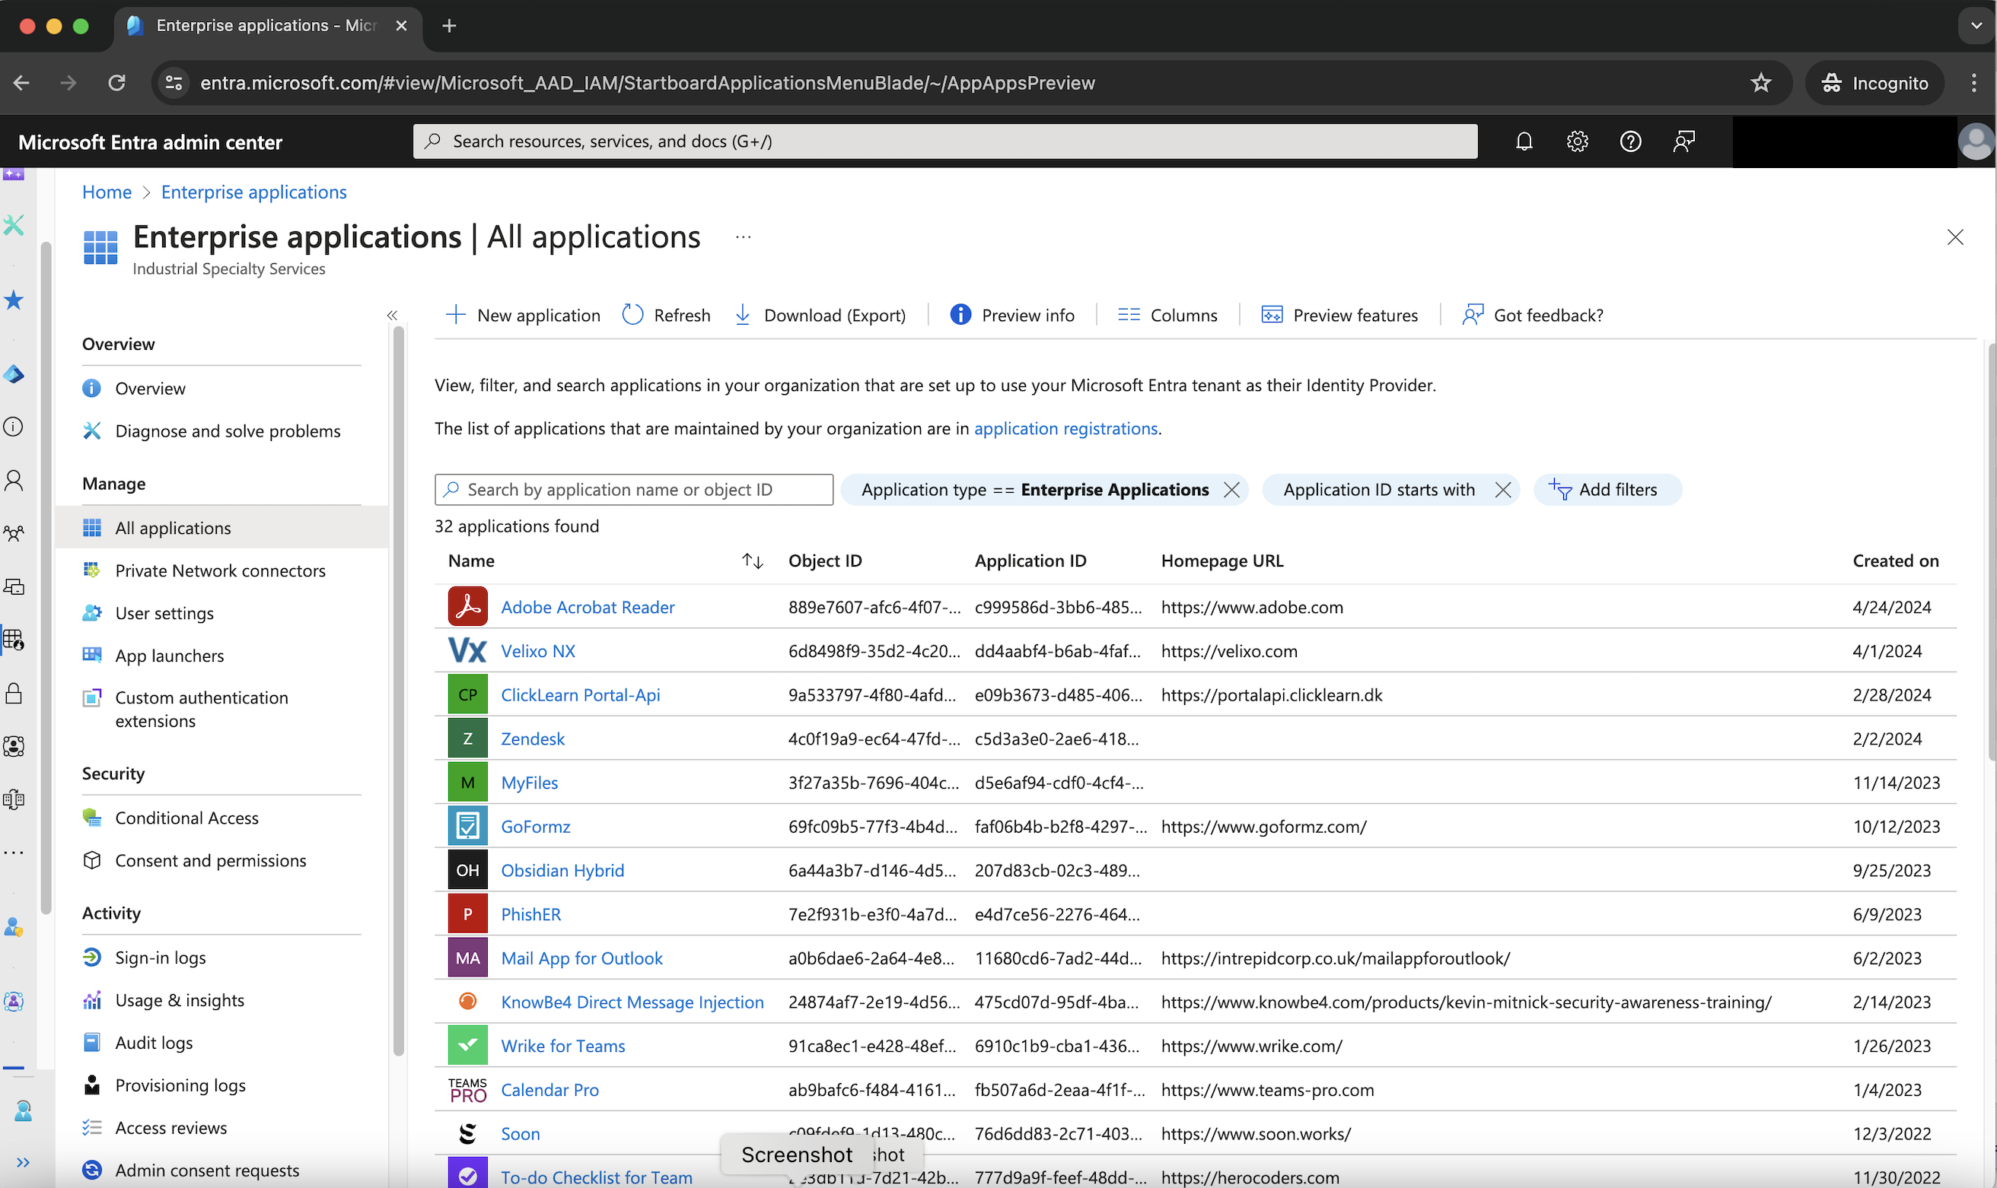

Slide 12
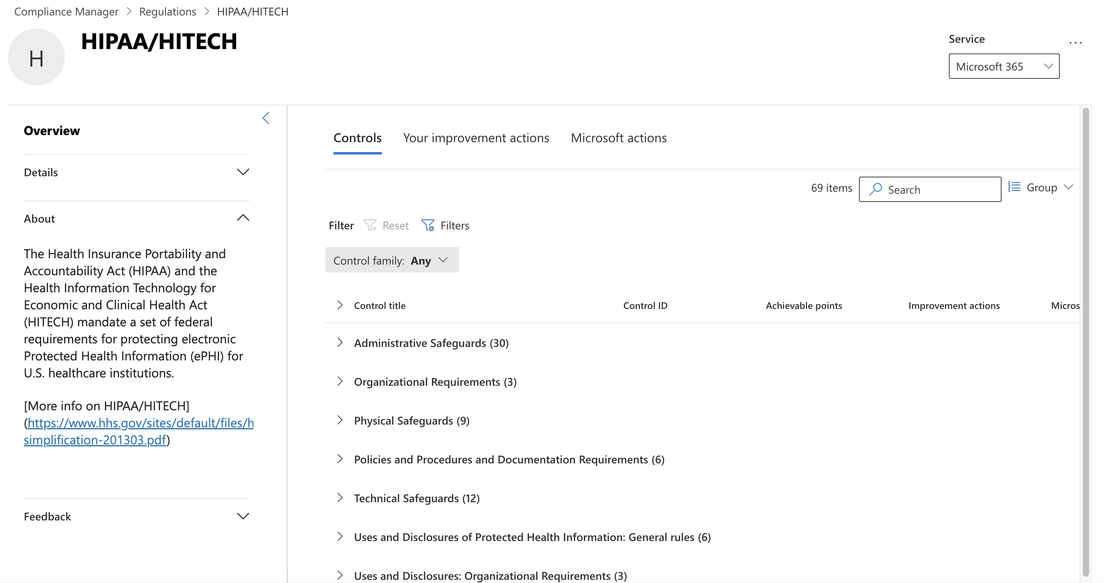

Slide 13
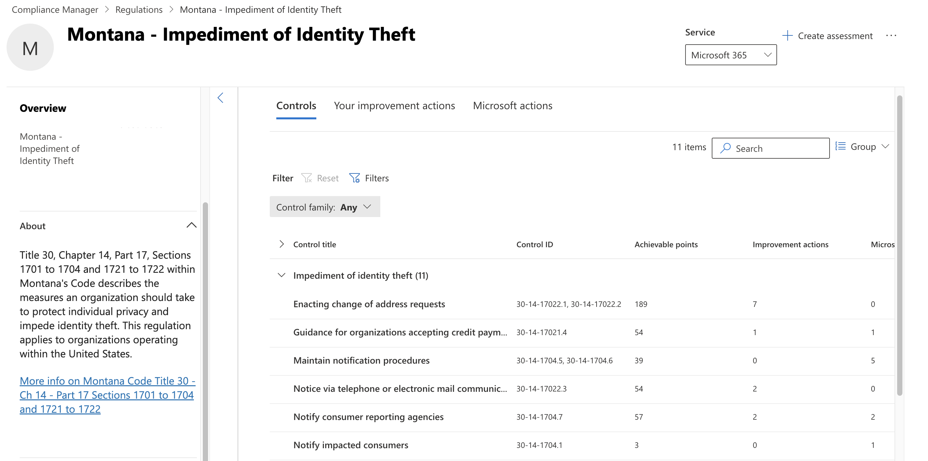

Slide 14
Appendix

Slide 16
Notes:
Opportunity for TetherView to provide secure compartmentalized environments for GenAI

Slide 18
Notes:
During the presentation, it was shared that they are confident the 2024 update to this is going to look much different. Dizzion acquired Frame from Nutanix.

